Slide 1
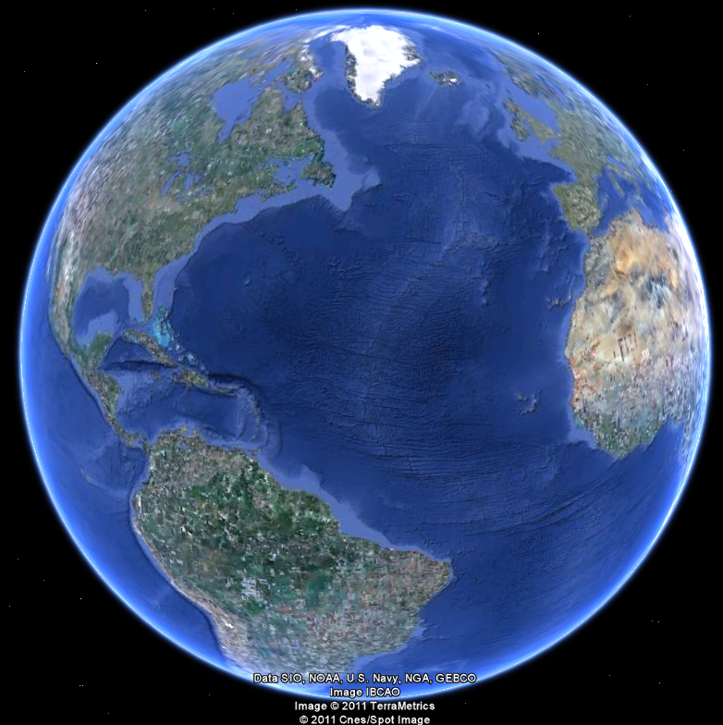
APEC 100 Sustainable Development
International Development and Food

Slide 2
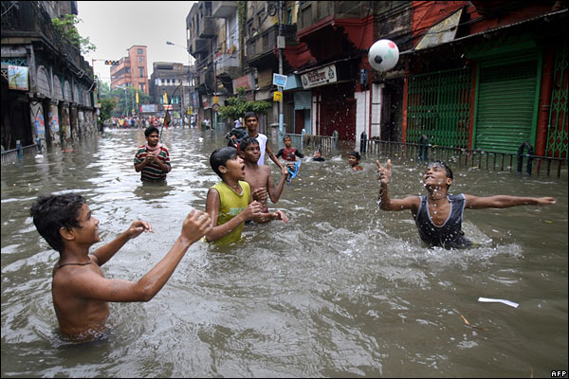
ENVIRONMENT IN INDIA: CLIMATE
Monsoons
June-October
winds from SW bring rain;
December-January
winds reverse and conditions are dry
Example: Bombay/Mumbai’s average rainfall:
January: 2.5mm
July: 682mm
Special thanks to Kate Zook and Dr. Joshua Duke
Notes:
Content source: National Environment Agency, Meteorological Services, Regional Weather: India: http://app.nea.gov.sg/cms/htdocs/article.asp?pid=1111, June 29, 2009.
Photo Source: telegraph.co.uk, “My Telegraph,” Onesite inc., http://images.onesite.com/my.telegraph.co.uk/user/will_heaven/20070716155109.jpg, June 29, 2009.

Slide 3
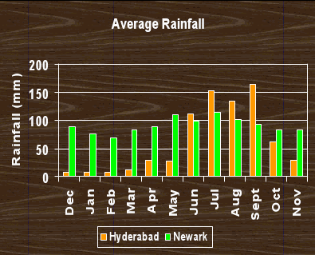
Climate Comparison: Delaware and Hyderabad
Difference in Rainfall:
In Delaware, there is little variation in monthly rainfall
In Hyderabad, India, there is a huge difference in rainfall between months!
Hyderabad CHART DATA TAKEN FROM (Jain 2007)
Newark CHART DATA TAKEN FROM : http://countrystudies.us/united- states/weather/delaware/newark.htm
Notes:
Content sources:
Chart created by Alison K. Kiliszek
Hyderabad CHART DATA TAKEN FROM (Jain 2007): Jain, Sharad, Pushpendra Agarwal, and Vijay Singh. Hydrology and Water Resources of India. Vol 57 Springer: The Netherlands 2007
Newark CHART DATA TAKEN FROM : http://countrystudies.us/united- states/weather/delaware/newark.htm
U.S. Department of State website (US weather, Delaware, Newark) <http://countrystudies.us/united- states/weather/delaware/newark.htm>.

Slide 4
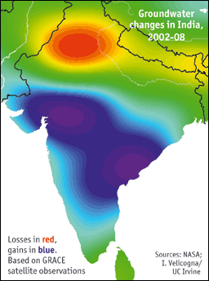
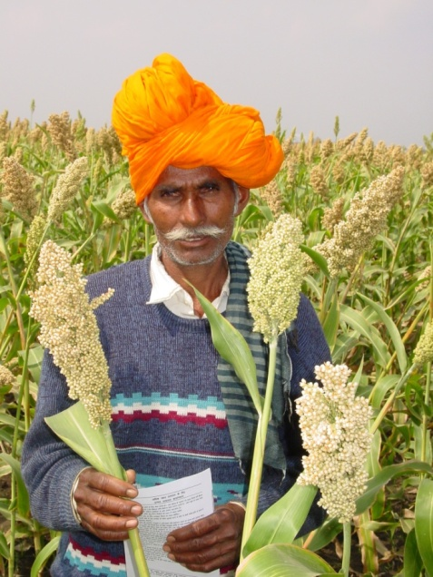
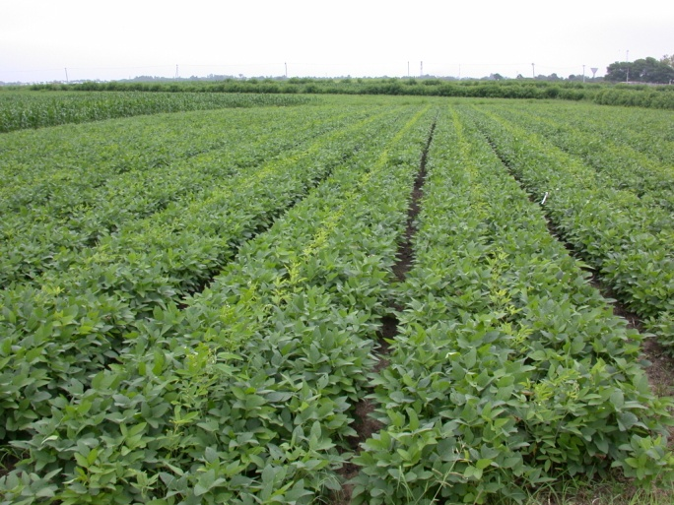
INDIA’S ECONOMY: AGRICULTURE
Crisis arose when agricultural processes faced diminishing returns. This combined with rapid industrialization taking the focus off of agriculture resulted in the food crisis of the 1960’s
India adopted new technology marked by high-yielding seeds and large inputs of fertilizers and water. Led to the “Green Revolution” of the 1970’s.
Three-to-fivefold increases were possible.
The benefits appear to be diminishing.
Notes:
Content source: Lal, “An Indian Economic Miracle?” Cato Journal, Vol. 28, No. 1 (Winter 2008), Cato Institute, p. 11-34.
Picture source: India/ICRISAT

Slide 5
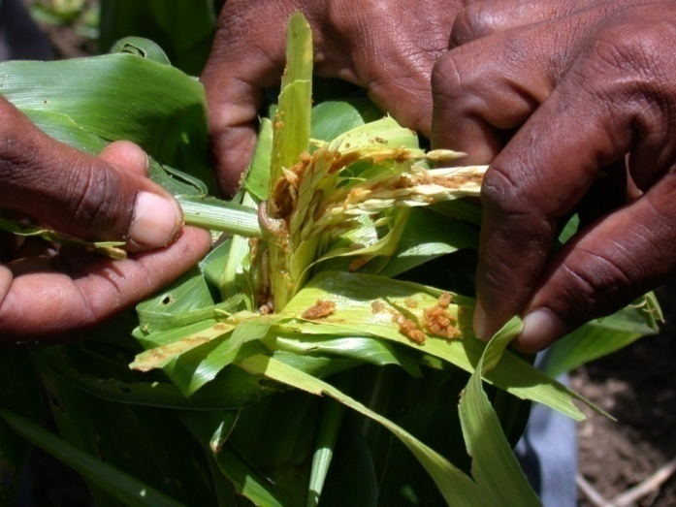
Pest Infestations and Freezing Temperatures
If temperature does not drop below freezing, pests are persistent for longer periods of time
Tuberworm example, as temperature increases, so does pest survival rate
Notes:
Picture from ICRISAT: India/APRLP

Slide 6
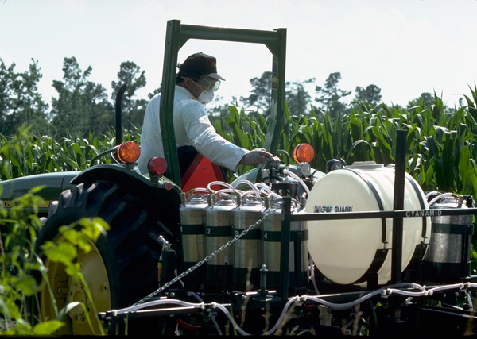
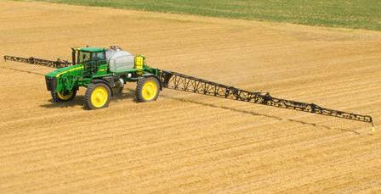
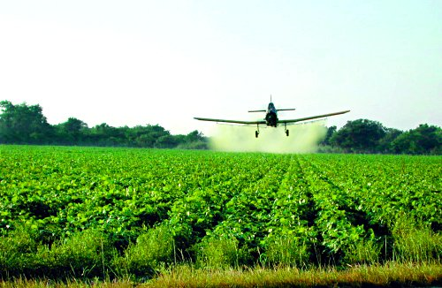
Pesticide Application
United States
Photo source: “Pesticide application,” U.S. Environmental Protection Agency Image Gallery, http://www.epa.gov/region2/mediacenter/imagegallery/, Aug. 11, 2009.
“Washington Begins Mandated Spray Study.” University of Florida IFAS Extension, Pesticide Information Office, 2006 < http://pested.ifas.ufl.edu/newsletters/november2007/washington.htm> Aug. 13, 2009.
Photo source: Barker Equipment Locator Service, “John Deere 4930 Sprayer,” http://www.ebarkers.com/jd-4930sprayer.htm
Notes:
Photo source: “Pesticide application,” U.S. Environmental Protection Agency Image Gallery, http://www.epa.gov/region2/mediacenter/imagegallery/, Aug. 11, 2009.
Photo source: Barker Equipment Locator Service, “John Deere 4930 Sprayer,” http://www.ebarkers.com/jd-4930sprayer.htm
Photo source: “Washington Begins Mandated Spray Study.” University of Florida IFAS Extension, Pesticide Information Office, 2006 < http://pested.ifas.ufl.edu/newsletters/november2007/washington.htm> Aug. 13, 2009.

Slide 7
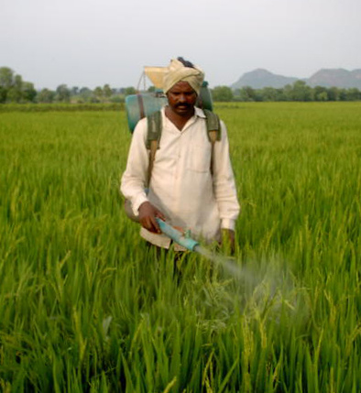
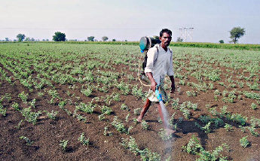
Pesticide Application
India
Photo source: Lalitha, R., “spraying pesticides,” flickr.com, Yahoo! Inc., http://www.flickr.com/photos/kalledaphotoproject/56750364/, Aug. 11, 2009
Photo source: Sivanandan, T.V., “Agriculture Department in Gulbarga indifferent to pest attack,” The Hindu Online Edition, http://www.thehindu.com/2008/10/27/stories/2008102753330300.htm, Aug. 11, 2009.
Notes:
Photo source: Lalitha, R., “spraying pesticides,” flickr.com, Yahoo! Inc., http://www.flickr.com/photos/kalledaphotoproject/56750364/, Aug. 11, 2009
Photo source: Sivanandan, T.V., “Agriculture Department in Gulbarga indifferent to pest attack,” The Hindu Online Edition, http://www.thehindu.com/2008/10/27/stories/2008102753330300.htm, Aug. 11, 2009.

Slide 8
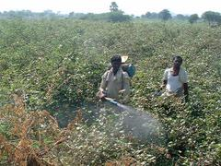
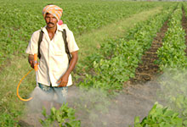
Agriculture and Pesticides
India is the largest producer of pesticides in Asia and ranks 12th in the world for the use of pesticides
Over 125 pesticide producers make more than 500 pesticide formulations in India
In the 1990s, more than 70% of the gross tonnage of pesticides used in agricultural practices in India consisted of formulations which are banned or severely restricted in the east and west
A bit of pesticide history…
Green Revolution→ large amounts of pesticides were used to increase yields
Population continues to increase, and to maintain high yields, pesticides are heavily applied
Crop loss due to pests is even more severe in India because of prevailing high temperature and humidity.
Sarvodaya Youth Org., Global Greengrants Fund
Content source: Devraj, Environment Bulletin, 2001
Notes:
Content source: Devraj, Ranjit. "ENVIRONMENT-INDIA: TOUGH ACTION NEEDED AGAINST PESTICIDES." Environment Bulletin (June 12, 2001): ITEM01169002. Academic OneFile. Gale. University of Delaware Library. 15 July 2009 <http://proxy.nss.udel.edu:2104/itx/start.do?prodId=AONE>.
Content source: P.C. Abhilash and Nandita Singh. “Pesticide use and application: An Indian Scenario.” Journal of Hazardous Materials 165. Nov 1, 2008. Eco-Auditing Group, National Botanical Research Institute, Council of Scientific and Industrial Research, Rana Pratap Marg, Lucknow 226001, Uttar Pradesh, India.
Photo source: Sarvodaya Youth Organization, Mike Lawrence, “India: Pesticide Deaths Prompt New Efforts to Regulate their Use in India,” Grantee Profiles, Global Greengrants Fund, Nov. 14, 2003 <http://www.greengrants.org/grantstories.php?news_id=24> July 29, 2009.

Slide 9
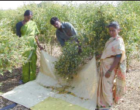
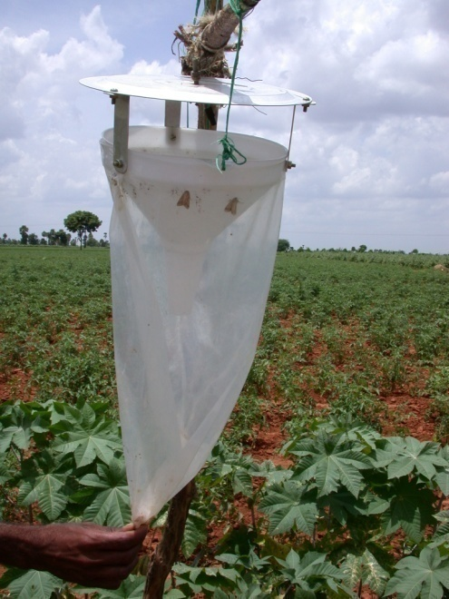
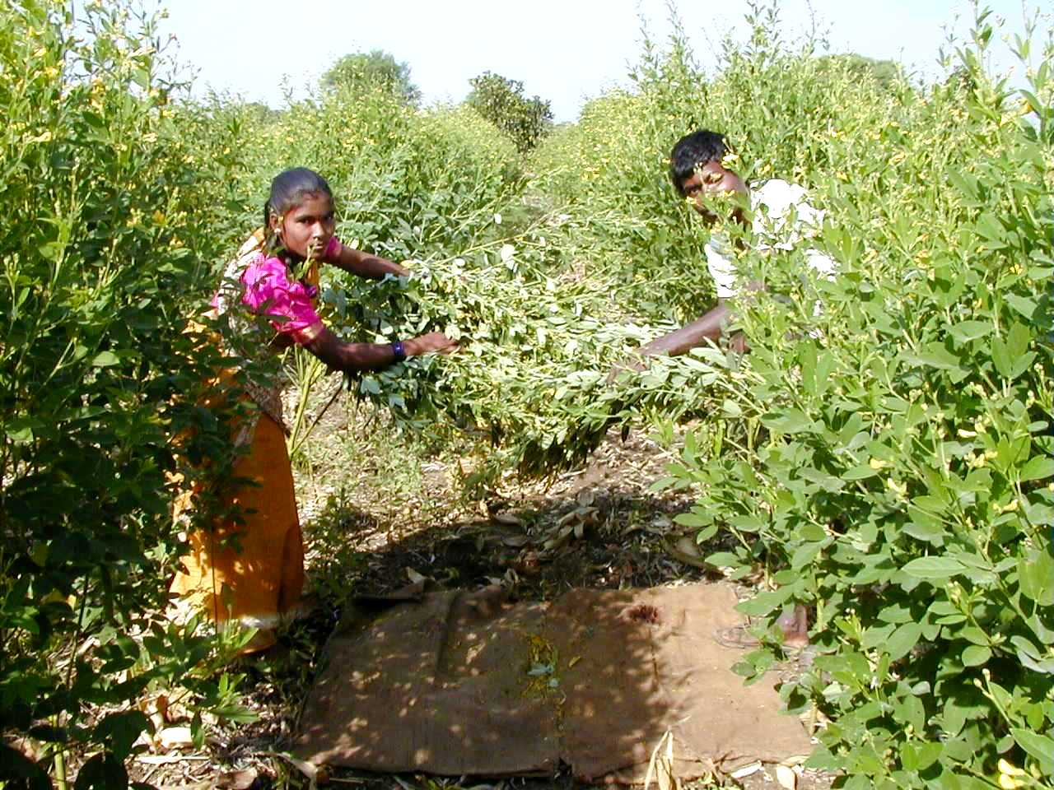
Alternatives to Pesticides
Planting seeds of high-yielding tolerant varieties
Use of biopesticides
(insect pathogens such as nuclear polyhedrosis virus, bacteria and fungi)
Use of plant-based pesticides
Use of pheromones
Shaking of pigeonpea
Content source: Rao et. al., Pesticide News No. 76, 2007
Notes:
Content source: Rao et. al. “Bio-intensive pest management reduces pesticide use in India.” Pesticide News, Integrated Pest Management, No. 76, June 2007 <http://www.pan-uk.org/Projects/Fairness/PN/pn76%20p16-17.pdf> July 29, 2009.
Photo source: ICRISAT photos, India, Kothapally selected pictures, IPM-Pigeonpea shaking

Slide 10
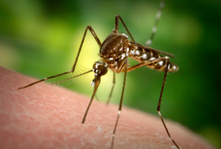
Insect-borne Illness: Malaria
One of the major public heath problems in developing countries
1.5-2.7 million deaths occur due to malaria annually
In southeast Asia, there were an estimated 21.9 million cases of malaria in 1995, with almost 32,000 deaths
India contributes about 80% of the cases in this region
Notes:
Content source: S. Lal, et. al. “Status of Malaria in India”, Journal of Indian Academy of Clinical Medicine, Vol. 5, No. 1, 2000.
Photo source: Dr. Mani, “Lessons From A Mosquito,” Money.Power.Wisdom Jan. 7, 2009 <http://guydz.com/moneypowerwisdom/lessons-from-a-mosquito/> July 29, 2009.

Slide 11

A brief history of DDT
DDT was banned in developed countries decades ago due to bioaccumulation and adverse environmental and health issues
Banned in the US in 1972
Exports from the US continued to 1985.
1962: Rachel Carson’s “Silent Spring” brought international attention to the potential dangers of DDT.
Notes:
Content source: Behreandt, Dennis. “Stopping Malaria.” The New American, February 21, 2005.
Photo source: US Fish and Wildlife Service, “Rachel Carson Centennial,” Jan. 5, 2009 <http://www.fws.gov/blackwater/carsoncent.html> July 29, 2009.

Slide 12
DDT and India
India still manufactures, uses, and exports DDT
Cochin, India, is home to the only major DDT-production facility in the world
DDT was banned for agricultural use in India in 1989, however India sought exception under the Stockholm Convention for use of 10,000 tons of DDT for restricted use in the public health sector
The national malaria program used 3,750 tons of DDT in 2001 in rural and semi-urban areas for residual spraying
Content source: Abhilash et. al., Journal of Hazardous Materials 165, 2008
Notes:
Content source: P.C. Abhilash and Nandita Singh. “Pesticide use and application: An Indian Scenario.” Journal of Hazardous Materials 165. Nov 1, 2008. Eco-Auditing Group, National Botanical Research Institute, Council of Scientific and Industrial Research, Rana Pratap Marg, Lucknow 226001, Uttar Pradesh, India.

Slide 13
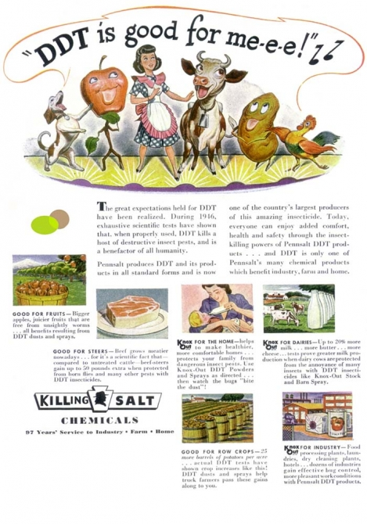
A brief history of DDT
DDT and the United States
As recently as the 1930s, the US experienced nearly 4 million cases of malaria per year
In 1939, it was discovered that DDT could effectively control insects
1949: over 4.6 million US households were sprayed with DDT.
1947: 15,000 cases of malaria in the US
1950: 2,000 cases
1951: malaria was considered eradicated from the US
Notes:
Content source: Behreandt, Dennis. “Stopping Malaria.” The New American, February 21, 2005.
Photo source: Gladwell, Max, “Food Monopoly: A Cornucopia of Conspiracy,” Max Gladwell: Social Media and Green Living, May 9, 2008 <http://www.maxgladwell.com/2008/05/food-monopoly-a-cornucopia-of-conspiracy/> July 29, 2009.

Slide 14
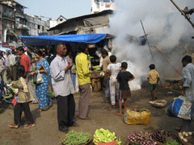
DDT and India
According to an executive at the government-owned Hindustan Pesticides Limited (2001): “We have permission to manufacture 10,000 metric tons of DDT annually, but since this country can use only half that amount the rest is exported.”
DDT is among the most commonly used pesticides in the developing countries of Asia because of their low cost and versatility against various pests
DDT being sprayed in a vegetable market in India
Notes:
Content source: P.C. Abhilash and Nandita Singh. “Pesticide use and application: An Indian Scenario.” Journal of Hazardous Materials 165. Nov 1, 2008. Eco-Auditing Group, National Botanical Research Institute, Council of Scientific and Industrial Research, Rana Pratap Marg, Lucknow 226001, Uttar Pradesh, India.
Photo source: Rzadigi, “Goodbye DDT,” Living on Earth, May 8, 2009 <http://www.livingonearth.org/shows/segments.htm?programID=09-P13-00019&segmentID=3> July 29, 2009.

Slide 15
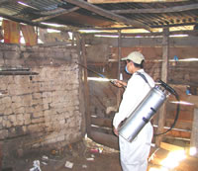
The DDT Dilemma
Bioaccumulation of DDT is a serious issue– but so is malaria
There are other ways to control malaria, but none are as cheap or effective as DDT
In 1996, South Africa stopped using DDT, and the death rate from malaria rose by around 1,000 percent
South Africa has since returned to using the pesticide.
Notes:
Content source: P.C. Abhilash and Nandita Singh. “Pesticide use and application: An Indian Scenario.” Journal of Hazardous Materials 165. Nov 1, 2008. Eco-Auditing Group, National Botanical Research Institute, Council of Scientific and Industrial Research, Rana Pratap Marg, Lucknow 226001, Uttar Pradesh, India.
Photo source: Stevens, Philip “WHO must take side of malaria victims,” CFD Bulletin Archives, Campaign for Fighting Diseases, Nov. 16, 2005 <http://www.fightingdiseases.org/main/content.php?content_id=51> June 29, 2009.

Slide 16
The DDT Dilemma
However, DDT builds up in plants and in fatty tissues of birds, fish, and other animals
DDT affects the nervous system, causing tremors and seizures in large doses
Studies have shown that DDT depletes breast milk in women and increases the chance of having premature babies
And yet 1.5-2.7 million deaths occur due to malaria annually.
Content source: Department of Health and Human Services, Agency for Toxic Substances and Disease Registry, September 2002
Notes:
Content source: “ToxFAQs for DDT, DDE and DD,” Department of Health and Human Services, Agency for Toxic Substances and Disease Registry, September 2002, Updated Sept. 11, 2007. < http://www.atsdr.cdc.gov/tfacts35.html#bookmark03> July 22, 2009.

Slide 17
What seems odd about these numbers?
 | US vs. India Agricultural Statistics (2003)
 | US | India
Wheat
Area (Ha) | 21,383,410 | 24,886,200
Production (million tonnes) | 63,589,820 | 65,129,300
Yield (Mt/ha) | 2.974 | 2.617
Milk
Number Cattle | 9,084,000 | 115,500,000
Production (lbs) | 170,312,000,000 | 194,227,253,000
Rate (lbs/cow) | 18,748.57 | 1,681.62
http://www.nddb.org/statistics.html
http://www.cdfa.ca.gov/Dairy/dairystats_annual.html
http://www.nue.okstate.edu/Crop_Information/World_Wheat_Production.htm

Slide 18
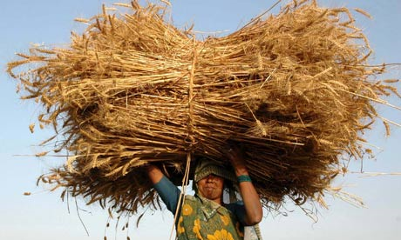
Why are India’s wheat yields so high?
Multiple cropping seasons, ideal growing conditions, high yielding varieties, heavy reliance on wheat to sustain its population
Wheat is the second major staple crop after rice in India
Stringer India, Reuters, guardian.co.uk
Notes:
Content source: R. Chatrath et. al. “Challenges to wheat production in South Asia.” Euphytica (2007)157:447-456. Springer Science and Business Media B.V. 2007.
Photo source: Stringer India/Reuters, Murray, James, “Indian farmers to insure themselves against climate change crop failure,” guardian.co.uk, June 8, 2009 <http://www.guardian.co.uk/environment/2009/jun/08/farming-india> July 29, 2009.

Slide 19
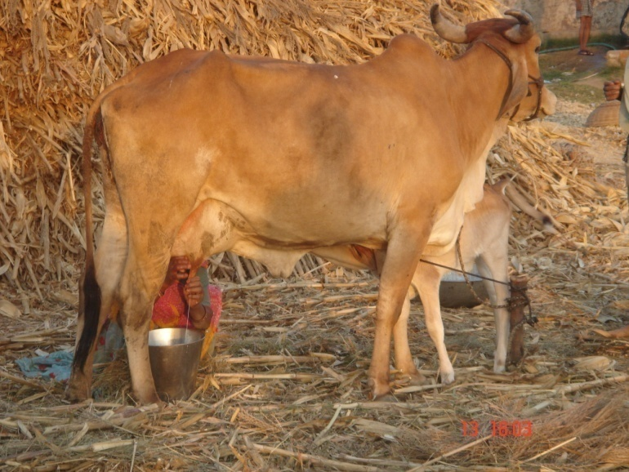
Why are India’s cows producing so little milk?
India produces more milk than any other country in the world, but per cow milk yields are surprisingly low
In order to achieve this, India must have a lot of cows…
India is home to 15% of the world’s cattle and 50% of the world’s buffalo populations
Content source: Rajendran, et. al., Indian Journal of Economics and Business, 2005
Notes:
Content source: Rajendran, K. et. al. “Efficiency of Milk Production in India: A Stochastic Frontier Production Function Approach.” Indian Journal of Economics and Business, Vo. 4, No. 2, 2005: 275-283.
Content source: Rakotoarisoa, Manitra et. al. “Competitiveness and trade potential of India’s dairy industry.” Food Policy, Vol. 31, Issue 3, June 2006: 216-227.
Photo source: ICRISAT photos, India, TATA-Album-SelectedPictures, Income Gactivity_7, Livestock

Slide 20
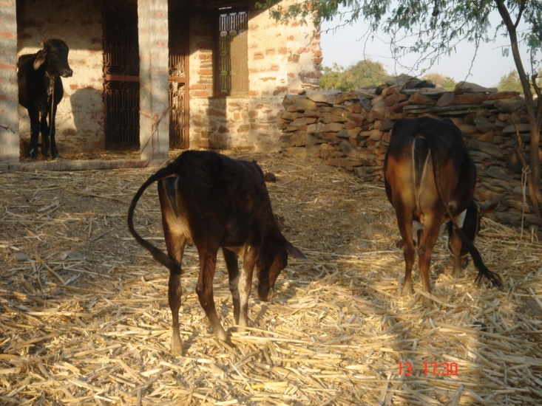
Why are milk yields per cow so low?
Millions of small-scale dairy producers operate in India
60% of India’s milk is produced on such farms
These farmers do not use modern scientific management practices
Dairying is only a second enterprise for many farmers.
Notes:
Content source: Rajendran, K. et. al. “Efficiency of Milk Production in India: A Stochastic Frontier Production Function Approach.” Indian Journal of Economics and Business, Vo. 4, No. 2, 2005: 275-283.
Content source: Rakotoarisoa, Manitra et. al. “Competitiveness and trade potential of India’s dairy industry.” Food Policy, Vol. 31, Issue 3, June 2006: 216-227.
Photo source: ICRISAT Photos, India, TATA –Album-SelectedPictures, Income Gactivity_7, DSC00669

